Slide 1
MIS630
Data and Knowledge Management
Information Modeling
Modeling and Database Design
Introduction to Information Modeling
Information Modeling Approach to Analysis
Information Modeling Guidelines
Specifying Behavior with Contracts
Info Modeling Homework
Copyright J. Morabito 2021

Slide 2
Modeling and Database Design
Looking for More Precision
Recall that a data model is a representation of some part of the real-world business domain, the primary purpose of which is the design of a database, provide specs to software developers, to interact w/ clients
In this course, so far, we have looked at the following:
  Normalization as a technique of design focused on functional dependencies
  ER modeling as a logical data modeling approach with richer semantics than FD and graphical notation
  Extended ER, through the inclusion of subtypes. “Extended ER” means ER + subtypes. This definition may depend on the CASE tool you are using.
In each of the above techniques we have progressed from a less to a more rich approach
In this lecture we will look at information modeling (IM), a form of modeling developed at Bellcore (a Bell Lab split-off) with the intent of making modeling, or more generally, analysis, more discipline
Copyright J. Morabito 2021

Slide 3
Information Modeling and
Software Development Life Cycle
Planning
Analysis
Design
Construction
Information
Modeling
Copyright J. Morabito 2021

Slide 4
Information Modeling and Analysis
Planning
Analysis
Design
Construction
Information Modeling
the info sys representation of the application domain.
The semantics of the “real world”
System
requirements
Information
requirements
What is the difference between
system and information
requirements?
Copyright J. Morabito 2021

Slide 5
Data Quality Perspective
Normalization
ER Modeling
Extended ER
Info Modeling
Formal Methods
representation
RW
IS
observation
interpretation
User
Difference between what is observed and what is interpreted is called data deficiency.
A key purpose of information modeling is to reduce data deficiency.
Copyright J. Morabito 2021

Slide 6
Importance of Good Concepts
“I like that so much I’m going to say it again:
“Concepts are much more important than methodologies and tools.
I think once this is realised in general, then we will end up with a better set of methodologies and languages which support the concepts and the whole process of software development.”
Ian Joyner ACUS (Australian Centre for Unisys Software)
“Competition … is ultimately driven by ideas, not technology … ideas come to life in the form of business models and ultimately become the soul of the business, what Peter Drucker has called the “theory of the business” … a successful business model must provide the right answers to a key set of questions.”
Stahlman, “Creative Destruction at IBM” Wall Street Journal, January 6, 1993
“Only in the last few years have business people experienced the insight of working with analysts who model the real business of business. Some of these business people have made a clear distinction between the value of modeling computer systems and the value of modeling the business … many of us were taught to conform the business to computer-based models … so today businesses are spending billions of dollars trying to reassemble into shared structures the very business data that we spent several decades decomposing into separate and disjoint islands.”
Shelton 1992
Copyright J. Morabito 2021

Slide 7
Information Modeling
Approach to Analysis
Copyright J. Morabito 2021

Slide 8
What We’re Doing That’s New
Promote understanding by explicitly using abstraction
> Encapsulation separates specification from implementation
> Information hiding is the result of hiding irrelevant details
> Separation of concerns: the importance of correctness
Precision … specification of behavior – Contract
Explicit specification of invariant, trigger, and pre- and post condition properties
Reuse
Separate generic from application-specific
Library of generic, reusable information modeling concepts precisely defined in terms of their invariants and their create, read, update, and delete behavior
“The purpose of abstracting is not to be vague, but to be create a new
semantic level in which one can be absolutely precise” (Dijkstra 1972)
Some say “object oriented”
We say “good analysis”
Copyright J. Morabito 2021

Slide 9
Entity Types, Attributes,
and Associations
employee
assignment
department
Employee.name
Employee.identifier
Employee.address
Department.name
Department.code
Department.description
Assignment.date
An entity type (e.g., employee) contains attributes (e.g., address) that all entity instances (e.g., John Smith) belonging to that type share
An entity type has behavioral (operational) properties that are shared with other entity types - this is represented by an association.
- Assignment of an employee instance to a dept instance. Note the sharing of behavior
- An association represents shared behavior among participating entities
Each association type is defined by contracts specifying all permitted behavior
- Assign employee to department
- Remove employee from department
- Terminate employee
The association type may or may not contain attribute properties
Copyright J. Morabito 2021

Slide 10
Entity Instances, Values,
and Association “Instances”
employee
assignment
department
John Smith
123-45-6789
100 Maple Street
John Smith assigned
To the Finance Dept
on February 7, 2004
Finance department
A100
Accounting and Finance
An entity instance is characterized or identified by its attribute values: John Smith, 123-45-6789, etc. The set of attribute values represents the state of an entity instance. A specific entity instance may be identified by some identifier: a unique value (123-45-678) corresponding to an attribute (e.g., social security number)
Attribute values are sometimes constrained by a lawful state space. E.g., Zip Code is constrained by a certain list of lawful zip codes, while name is constrained by only type (e.g., character) and length.
Each association instance associates corresponding entity instances.
Copyright J. Morabito 2021

Slide 11
Generic Associations
KEY IDEAS
Associations define jointly owned behavior among participating entities
Associations are distinguished by their corresponding invariant
All permitted behavior is constrained (i.e., must not violate) by the invariant of the association
A contract is used to specify each behavior associated with a given association/invariant
A given entity of a corresponding type may participate in any number of behaviors with many entities of different types. Thus, a given entity and type may play many roles, depending on its associations with other entities and types (see next slide)
Copyright J. Morabito 2021

Slide 12
Role of Objects in
Generic Associations
Generic Association
Dependency
Reference Association
Composition
Subtyping
Relationship Association
Parent
Maintained Entity
Composite
Supertype
Relationship
Generic Object (Role)
Dependent
Reference Entity
Component
Subtype
Regular Entity
Copyright J. Morabito 2021

Slide 13
Information Modeling
Guidelines
Copyright J. Morabito 2021

Slide 14
Symmetrical and Asymmetrical
Generic Association
Dependency
Reference Association
Composition
Subtyping
Relationship Association
Parent
Maintained Entity
Composite
Supertype
Relationship
Generic Object (Role)
Dependent
Reference Entity
Component
Subtype
Regular Entity
The Relationship is a symmetrical association,
meaning the participating entities have an “equal” association with each other.
All other associations are asymmetrical,
meaning the behavior each way is different.
Copyright J. Morabito 2021

Slide 15
Relationship
Invariant
The existence of a relationship instance implies the existence of exactly one instance for all participating (regular) entity types
Copyright J. Morabito 2021

Slide 16
Relationship
A relationship instance is an entity instance. The line between entities becomes an entity (not just a line)
  It may have properties (always an identity)
  A relationship may participate in other associations
  In Extended ER, this is sometimes known as as associative entity (with certain qualifications, to be discussed in a subsequent lecture)
A relationship may exist only if participating entities exist
A relationship is symmetrical (unlike all other generic associations)
  If a participating entity instance is deleted, the relationship instance is deleted. It is not necessary that all other participating entities be deleted
  The other participating entities in the relationship are unaffected
  Entity instances may be created separately from the relationship and from each other (default)
Copyright J. Morabito 2021

Slide 17
Relationship Example
Assignment
Rel
Employee
Department
NOTE: Employee and Department are independent on each other. There is no line between them, only a connection to a relationship entity type. Hence, we say the association is symmetrical from which follows specific properties and characteristics that distinguish this type of association from the other, asymmetrical association types
Copyright J. Morabito 2021

Slide 18
Relationship Example - 2
If we terminate an employee instance we must delete all corresponding instances of assignment. The corresponding department instance is unaffected.
Similarly, if we close a department (through a reengineering effort) we must delete all corresponding instances of assignment, but not the corresponding employee instances (formerly assigned to that department). (This is what the model tells us.) However, if the elimination of a department means that its employees are also terminated, then that is not an “equal” or symmetrical association. What kind of an association is it?
Copyright J. Morabito 2021

Slide 19
Relationship Example – 3
Employee
D
Department
The direct connection between Employee and Department means that this is an asymmetrical association, in this case a dependency association. Deleting the Employee (child or dependent) instance has no effect on the corresponding Department (parent) instance. On the other hand, deleting the parent Department instance, requires that all corresponding dependent (child) instances be deleted.
In most companies, the latter is a “long-duration transaction” where the employee is a given a certain amount of time to reconnect to another department.
Copyright J. Morabito 2021

Slide 20
Data Warehouse – Star Schema
Time Dimension
time_key
time attributes
Product Dimension
product_key
product attributes
Sales Fact
time_key
product_key
store_key
customer_key
dollar_sales
unit_sales
dollar_cost
Customer Dimension
customer_key
promotion attributes
Store Dimension
store_key
store attributes
All the advantages of a Star Schema stem from the fact that a Star Schema is a relational database implementation of a relationship.
What are those advantages … what does symmetry give us?
Copyright J. Morabito 2021

Slide 21
Dependency
Invariant
The existence of a dependent instance implies the existence of a corresponding parent instance(s).
Aside: A dependent instance may have more than one corresponding parent instance
Copyright J. Morabito 2021

Slide 22
Dependency Association (1)
A dependent entity instance may exist only if another parent entity instance exists
A dependent instance may have more than one parent instance of the same type
A dependent instance can not be created unless its parent instance exists
If it is mandatory that a dependent instance exists, then the dependent and and its parent instances must be created in the same business process
Copyright J. Morabito 2021

Slide 23
Dependency Association (2)
Delete rules (an example of permitted operations)
  Delete parent instance, cascade to delete dependent instances
  Delete parent instance only if it has no dependent instances
    Delete dependent instance first, in a separate business process
    Requires that the dependent instance be optional
  Delete parent and dependent instances in the same business process
    Requires that dependent be mandatory
Different delete rules may exist for different instances of the same dependent entity type
  e.g., a savings account is required of all customers
    If delete a customer’s savings account, then we must also delete the corresponding customer instance (no longer a customer)
    But, it is OK to delete a checking account without affecting the corresponding customer instance
Copyright J. Morabito 2021

Slide 24
Dependency Examples
Department
Employee
Bank
Customer
D
D
D
D
Employee
Savings Plan
Savings
Account
Checking
Account
Copyright J. Morabito 2021

Slide 25
Dependency Example-2
FCU
Customer
D
D
D
Savings
Account
(Mandatory)
Savings
Account
(Optional)
Checking
Account
(Optional)
Copyright J. Morabito 2021

Slide 26
Reference
Invariant
The existence of a maintained entity instance implies the existence and property value correspondence of a corresponding reference entity instance
Copyright J. Morabito 2021

Slide 27
Reference
A set of read-only instances used to create, update, or delete instances of other “maintained” instances
Reference entity instances may be used to validate (precondition) maintained entity instances
Reference entity instances may be used as a trigger to an operation on maintained entity instances
Reference entity instances may be read (but not created, updated, or deleted) during a CRUD operation on a maintained entity instance
When a reference entity instance is changed, all instances of the maintained entity must be examined and if necessary, changed too. These operations should take place in the same business process.
You may want to keep more than one version of both reference and maintained entity instances (an audit trail)
Copyright J. Morabito 2021

Slide 28
Reference Examples
Employee
Diagnosis
Patient
D
Ref
Ref-C
D
Job
Classification
Symptoms
NOTE: A “reference-for-create” exists only for a create operation on the maintained entity
Copyright J. Morabito 2021

Slide 29
Reference Example (2)
Selected Semantics
A traffic ticket is issued only when the automobile (a monitored object) exceeds the speed limit on the road that the auto is traveling on
Moving automobile
Traffic ticket
Speed limit
Copyright J. Morabito 2021

Slide 30
Reference Answer
Traffic Ticket
Automobile
Ref-C
Ref-C
Speed Limit
Copyright J. Morabito 2021

Slide 31
Notification: Generic Reference
Notification
Observed Object
Ref-C
Ref-C
This is a common modeling idea in networks or communication.
E.g., “Alerts” are really notifications
Criteria
Copyright J. Morabito 2021

Slide 32
Composition
Invariant (Generic)
A composite type corresponds to one or more component types, and a composite instance contains zero or more component instances of each of these types
The composite instance contains deliberate and emergent or resultant properties. The former is specific to the composite instance while the latter corresponds to properties of corresponding component instances
Copyright J. Morabito 2021

Slide 33
Composite Entity (1)
A composite entity consists of components
There need not be an existence dependency between composite and component
Creating, updating, or deleting a component instance does not not necessarily change the identity of the composite
A component may belong to 0, 1, or N composite instances
A component may belong to more than one type of composite
Some behavior of a composite may may be propagated to its components; e.g., “move”
Properties (structural or behavioral) of a composite that are dependent on properties of a component are known as emergent or resultant (hereditary) properties
Properties of a composite that are independent of properties of its components are known as deliberate properties. A composite must have at least one deliberate property (identity)
Copyright J. Morabito 2021

Slide 34
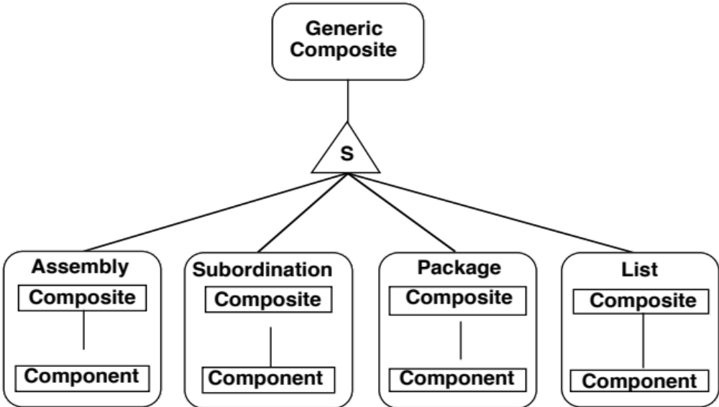
Composite Entity (2)
Categories
Linkage – concerns how the composition is created … internal dependencies
Serializability
components ordered or not ordered
Changeability
components static or variable
Hierarchy
components are hierarchical or not (network) … org chart is a hierarchical composition
Linkage Categories
Copyright J. Morabito 2021

Slide 35
Composition Example
Automobile
C
Engine
Transmission
Wheels
… Etc.
What kind of composition is this?
Name several resultant properties of an automobile
Copyright J. Morabito 2021

Slide 36
System Properties of Compositions
System (or “bulk”) properties arise as a consequence of the composition association.
  Resultant properties (also known as hereditary properties) exist in at least one component
  Emergent properties do not exist in any component
POP QUIZ. Model the property of “thinking” in the entity types of HUMAN, BRAIN, NEURON
Copyright J. Morabito 2021

Slide 37
Thinking Composition
Macro-structure
Human
C
Where does thinking originate?
Where does it exist?
How do we classify thinking at the different levels?
Brain
Other organs
C
Neurons
Copyright J. Morabito 2021

Slide 38
Subtype
Invariant (Generic)
The existence of a subtype instance implies the existence of a corresponding supertype instance with the same object-identifier
Thus, the corresponding supertype and subtype instances represent the same entity instance in the real-world (same identifier); hence the “is-a” association
This is also known as an inheritance hierarchy: a subtype instance inherits all properties (structural & behavioral) of the supertype instance, though behavior-inheritance may be overridden (rare)
Copyright J. Morabito 2021

Slide 39
Subtype Entity (1)
A subtype “is a” supertype; i.e., same identity
A supertype is an abstraction of common properties from a set of subtypes (looking up)… the set of properties of a supertype is a (common) subset of properties of its subtypes
Subtyping represents a classification hierarchy (looking down)
Subtypes extend properties of the supertype
  Generally, all properties are inherited down (i.e., inheritance hierarchy)
  Behavior inheritance may be overridden for selected subtypes
  There is no upward inheritance
There may be more than one classification hierarchy for the same supertype… this may lead to multiple inheritance
There are generally two pairs of constraints on subtypes
  Overlapping or Disjoint: Can a given supertype instance be represented in more than one subtype?
  Exhaustive or Non-exhaustive: Are all supertype instances represented in the set of subtypes?
Copyright J. Morabito 2021

Slide 40
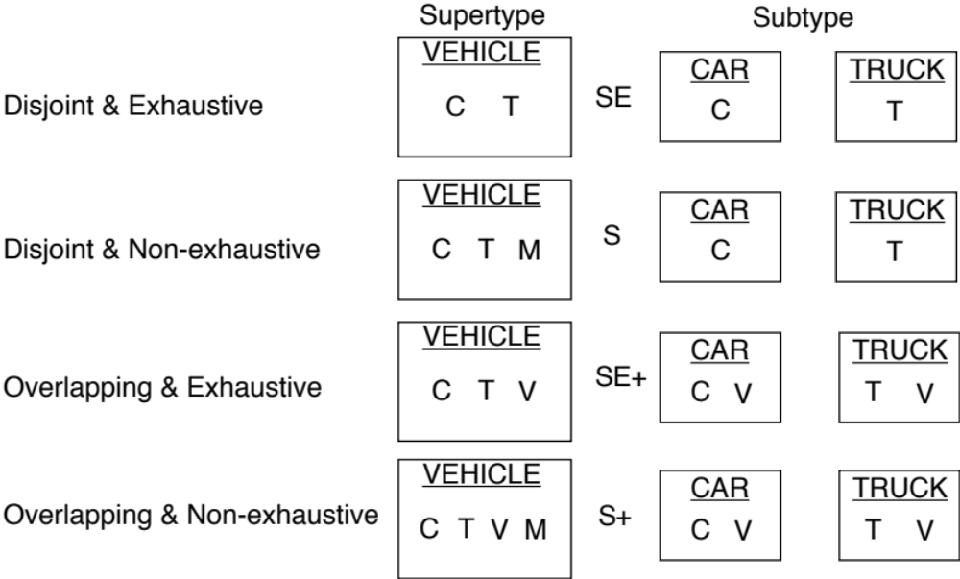
Subtype Entity (2)
Four Subtype Categories
Copyright J. Morabito 2021

Slide 41
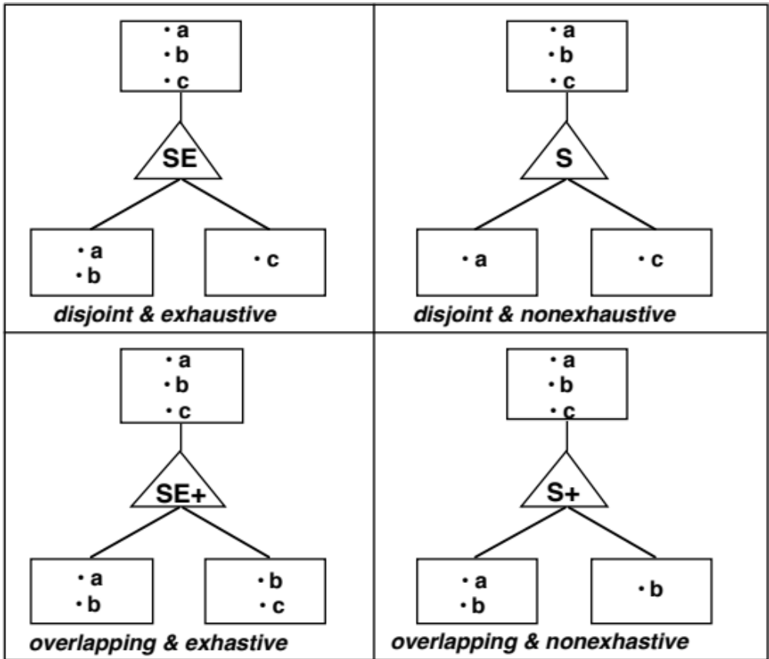
Subtype Entity (3)
Instance Diagrams
Copyright J. Morabito 2021

Slide 42
Enterprise Vs. Application Modeling
Subtype Example
Enterprise modeling
at this level
i.e., to be shared across applications
Household
Leads to the notions of application modeling vs. enterprise modeling
Also, master data management
Generalization
S+
15-17 Subtypes
Marketing
Household
Statement
Household
…..
Household
…..
Household
Typically, subtypes are discovered in application modeling while the “big picture” is realized at the enterprise level
Marketing
application
Operations
application
….
….
Application modeling
at this level
Copyright J. Morabito 2021

Slide 43
Specifying Behavior
With Contracts
Formalization used in place of natural language system requirements
Used with corresponding data models
Copyright J. Morabito 2021

Slide 44
Introduction to Contracts
Contracts define and communicate rules of behavior
Contracts exist at all levels in systems analysis, design, and implementation; in fact, contracts exist at all levels in an organization and in society
  We use contracts all the time – e.g., to purchase real estate
Though properties of contracts may differ based on their intended uses, contracts have some properties in common: The essential property is that a contract explicitly and declaratively defines a behavior (or in info systems, we say an operation)
A contract should describe
  What the operation has to achieve and under what circumstances (semantics) and its signature (parameters)
Copyright J. Morabito 2021

Slide 45
Formalism
Contracts exist at all levels in info management
  A top level description of a function or behavior
  A low level description of an update to an attribute in a tuple in a database. Note that the implementation of an operation is separated from its specification (abstraction), so that, for example, we may maintain referential integrity (e.g., a delete cascade) with code or in the DBMS level (data level)
Managing behavior at different levels is called refinement
  Systems may be seen as layers containing each other, so that as we open one level we reveal several sub-components
    Opening a higher level contract may reveal any number of lower level contracts that implement the higher level contract
Who defines a contract?
  Specialists define contract, as in lawyers or systems analysts
Formal notation is the language of a contract
  Remove ambiguity
  There is an upfront cost - i.e., specialists who know the language
Copyright J. Morabito 2021

Slide 46
Contracts (1)
A contract is a mechanism for the (formal) specification of behavior - the complete and unambiguous definition of an operation
Each contract is between a customer (i.e., client) and an implementor (i.e., server)
The contract specifies customer expectations (the final state) and the implementor’s requirements
People use contracts all the time - and always have
The initial state is called a precondition and the final state a postcondition
Pre- and post-conditions are either TRUE or FALSE; there are no side effects
A contract is initiated by a trigger. The trigger may be a contract’s precondition or some outside event (i.e., time)
Copyright J. Morabito 2021

Slide 47
Contracts (2)
A contract is described by its signature (operation parameters) and its semantics (pre- and post-conditions)
Contracts typically specify jointly owned behavior
The implementation of a contract at any level is hidden; only behavioral semantics are specified (this is abstraction)
Specifying an operation (i.e., a contract) means specifying assertions:
- what must be TRUE before (pre-) and after (post-) performing an operation
- this is abstraction (filtering) … addressing only those assertions necessary for the specification of a given behavior
We have defined a generic object class library of CRUD contracts that may be reused in any application
Contracts may not be visible - they may only be implemented
Copyright J. Morabito 2021

Slide 48
Design by Contract
Specification with Contracts
Formal methods and contract are necessary for mission-critical applications
A contract is a self-contained construct
We specify behavior on the basis of its assertions
A contract – its assertions – supports formal methods such as “Z”
  - “Z” is based on axiomatic set theory, lambda calculus, and first-order predicate logic
Another popular formal method is Vienna development method (VDM) … similar to “Z”
A contract is independent of its implementation. This is called encapsulation. (Separation of concerns)
A contract specification may be implemented in any number of ways (i.e., refinement paths)
Invariant
Pre-condition
Post-condition
Trigger
Contracts
Formal Methods
(“Z”, “VDM”)
Copyright J. Morabito 2021

Slide 49
Design by Contract: Levels
Hire an Employee
Update Payroll
Update Health Insurance
Update 401K
…
…
Add Dependents
Add Benefices
default
Contracts may be “forward engineered” into any implementation language.
“Super” contracts call sub-contracts.
Contracts specify behavior, including “jointly owned” behavior.
Therefore, a contract does not map to a method. There are many methods to one contract.
To use contracts, we need a good CASE tool to manage contract compositions & dependencies
(The same with methods – “Business Objects: Stacks vs. Customers”)
Copyright J. Morabito 2021

Slide 50
Refinement
Contract Map
Refinement is a series of design decisions where each decision adds information to a prior, higher level decision, that facilitates managerial choice. Refinement ends when sufficient information has been added to allow for implementation to take place.
Super Contract
Refinement permits us to start with a high-level requirement (super contract) and refine to constituent subcontracts
Refinement covers both analysis and implementation
implementing
specifying
Copyright J. Morabito 2021

Slide 51
An Example of a Contract
Specification of Assign an Employee to a Department
Each Contract is usually associated with a corresponding data model (or portion thereof) in addition to its assertions
Invariant (always applies)
1. An employee belongs to at most one department
2. A department consists of zero to 100 employees
Precondition
1. The department and employee exist
2. The employee does not belong to another department
3. The department has less than 100 employees
Postcondition
1. The employee belongs to the department
2. The department has all the old employees, and one additional employee (i.e., increment employee count by one)
Trigger
1. The department has approved an employee transfer request
Copyright J. Morabito 2021

Slide 52
Generic & Application
Specific Assertions
Specification of Hire an Engineer
(a subtype of Hire an Employee)
Invariant (always applies)
1. An engineer is an employee
Precondition
1. The employee & corresponding engineer instances do not exist
2. The engineer must have at least 5 years experience
3. The engineer must have a Professional Engineer’s license
Postcondition
1. The employee and engineer instances exist
Trigger
1. The department has approved an employee requisition
Can you distinguish between employee-specific and engineer-specific assertions?
Copyright J. Morabito 2021

Slide 53
Individual Project Assignment
State any assumptions before each exercise
You are to use the information modeling concepts and notation that is the subject of this lecture
Use PowerPoint
Copyright J. Morabito 2021

Slide 54
Implementation Exercise #1
Discuss the database table options available when implementing subtype associations.
Discuss the considerations you would use in choosing one design over the others
Your answer should be in the form of a textual description and possibly graphics (you may use PowerPoint)
Copyright J. Morabito 2021

Slide 55
Exercise #2
Selected Semantics
An employee must belong to one and only one department (if a Department is dissolved, the Employee instances must be assigned to another department or be terminated)
A project need not have anyone assigned to it
An employee need not be assigned to a project
Department
Employee
Project
Copyright J. Morabito 2021

Slide 56
Exercise #3
Shipping Order
Line Item
Supplier
Part
Selected Semantics
A shipping order must include at least one line item
A line item represents a part from a given supplier
Copyright J. Morabito 2021

Slide 57
Exercise #4
Hint: Recursion Example
Selected Semantics
Large parts contain small parts
But several small parts contain other small parts
(This is known as the
“parts-explosion” example)
Parts
Large Parts
Small Parts
Copyright J. Morabito 2021

Slide 58
A More Complex Example #5
Doctor
Patient
Subscriber
Symptom
Appointment
Bill
Payment
Insurance Company
Selected Semantics
A patient need not have insurance
Both patient and/or the insurance company may make payments
A bill can have several payments associated with it
Copyright J. Morabito 2021

Slide 59
Another Complex Example #6
Employee
Department
Office Equipment
Equipment Ownership
Job Classifications
Job Title #1, …Job Title #n
Supervisor
Supervisee
Benefits
Selected Semantics
Office arrangement
Copyright J. Morabito 2021

Slide 60
Subtyping Example 7
Subtype the entity “Stevens Community”; that is, the community
Identify the criteria for each subtype
Subtype to 2 or 4 levels
Hint: I’m asking you to subtype the Stevens community (i.e., people), not the Stevens physical structures or policies.
Copyright J. Morabito 2021

Slide 61
Exercise 8: Contract Development
Develop the specifications for a major activity, such as purchasing a new home or purchasing an automobile
The solution should contain a contract map, with a set of interrelated contracts (contract map – see slides #48-50)
  The major activity corresponds to the super contract
  The super contract level should contain 2 subcontracts (several)
Each contract (super & sub) is to be fully specified in terms of its {invariants, pre-conditions, post-conditions, triggers} (see 2 examples on sides 51-52)
Any major activity is OK (hiring an employee is used as an example on slide 49), keeping in mind the requirement for a contract map, with a specification for a super contract and at least 2 subcontracts
  Use slide #49 as a guide. Each contract will be specified as shown in slides #51 or #52
Copyright J. Morabito 2021

